Slide 1


Engineering Economics| ME 2001 | 3 Credits | 3 0 0 3
Lecture 5
Indian Industries

Slide 2
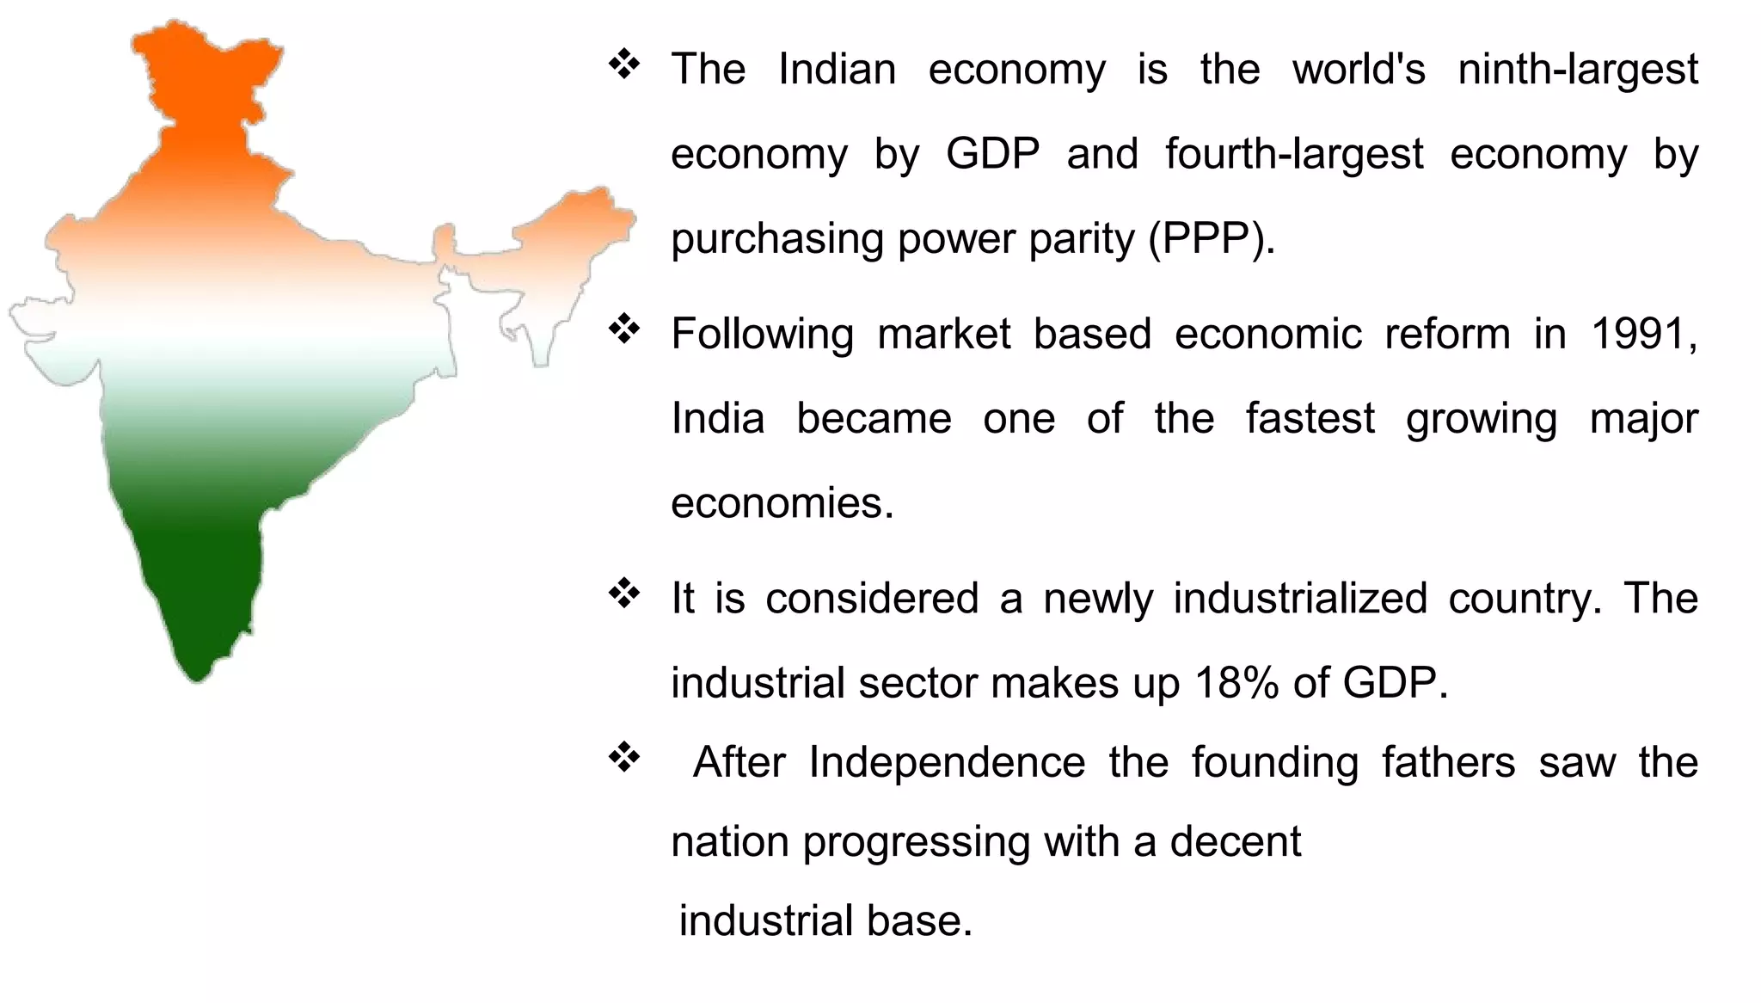
Indian Industries: Introduction

Slide 3
Indian Industries- Development
Indian industrial landscape is continually evolving, and future progress will depend on a multitude of factors, including government policies, global economic conditions, and technological advancements.
Pre-Independence Era: The early stages of industrialization in India were primarily focused on the establishment of industries for raw material processing and export-oriented industries like textiles, jute, tea, and mining.
Import Substitution Industrialization (ISI) (1950s-1980s): After independence, India adopted a policy of import substitution to promote domestic industries. The government imposed high tariffs and restricted imports of certain goods to encourage local production and reduce dependency on foreign imports.
Mixed Economy and Licensing Raj: During this period, India adopted a mixed economy approach with a combination of private and public sectors. However, the government heavily controlled and regulated the private sector through the licensing system, which often led to bureaucratic red tape and inefficiencies.
Economic Liberalization (1990s-present): In 1991, India initiated economic reforms and liberalization to open up the economy to foreign investments and reduce government control over industries. This policy shift aimed to enhance competitiveness, improve productivity, and attract foreign direct investment (FDI).
Information Technology and Services Sector: India's industrialization also witnessed a significant shift towards the information technology (IT) and services sector. India became a global hub for IT services, software development, and business process outsourcing (BPO).
Special Economic Zones (SEZs): The government of India established Special Economic Zones to attract foreign investment and promote exports. These SEZs offer various incentives and tax benefits to industries, making them attractive destinations for manufacturing and export-oriented businesses.

Slide 4
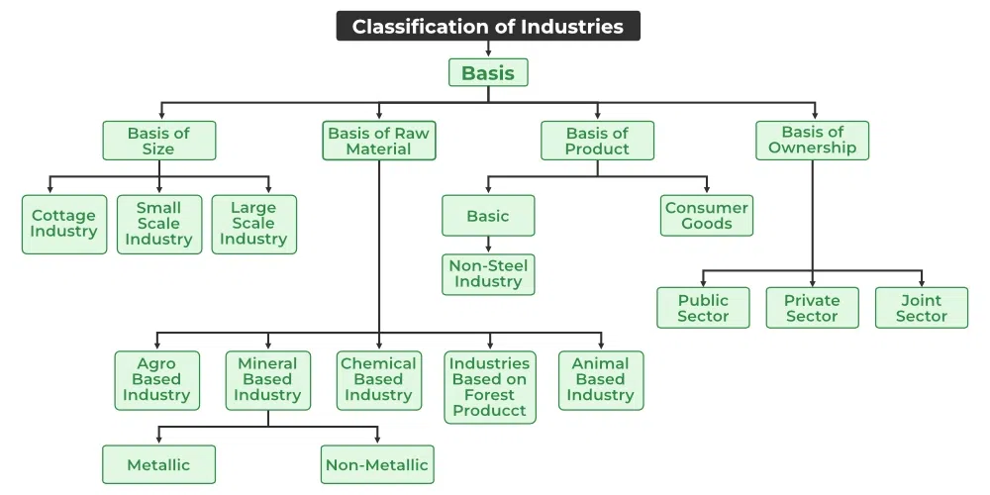
Indian Industries- Types

Slide 5
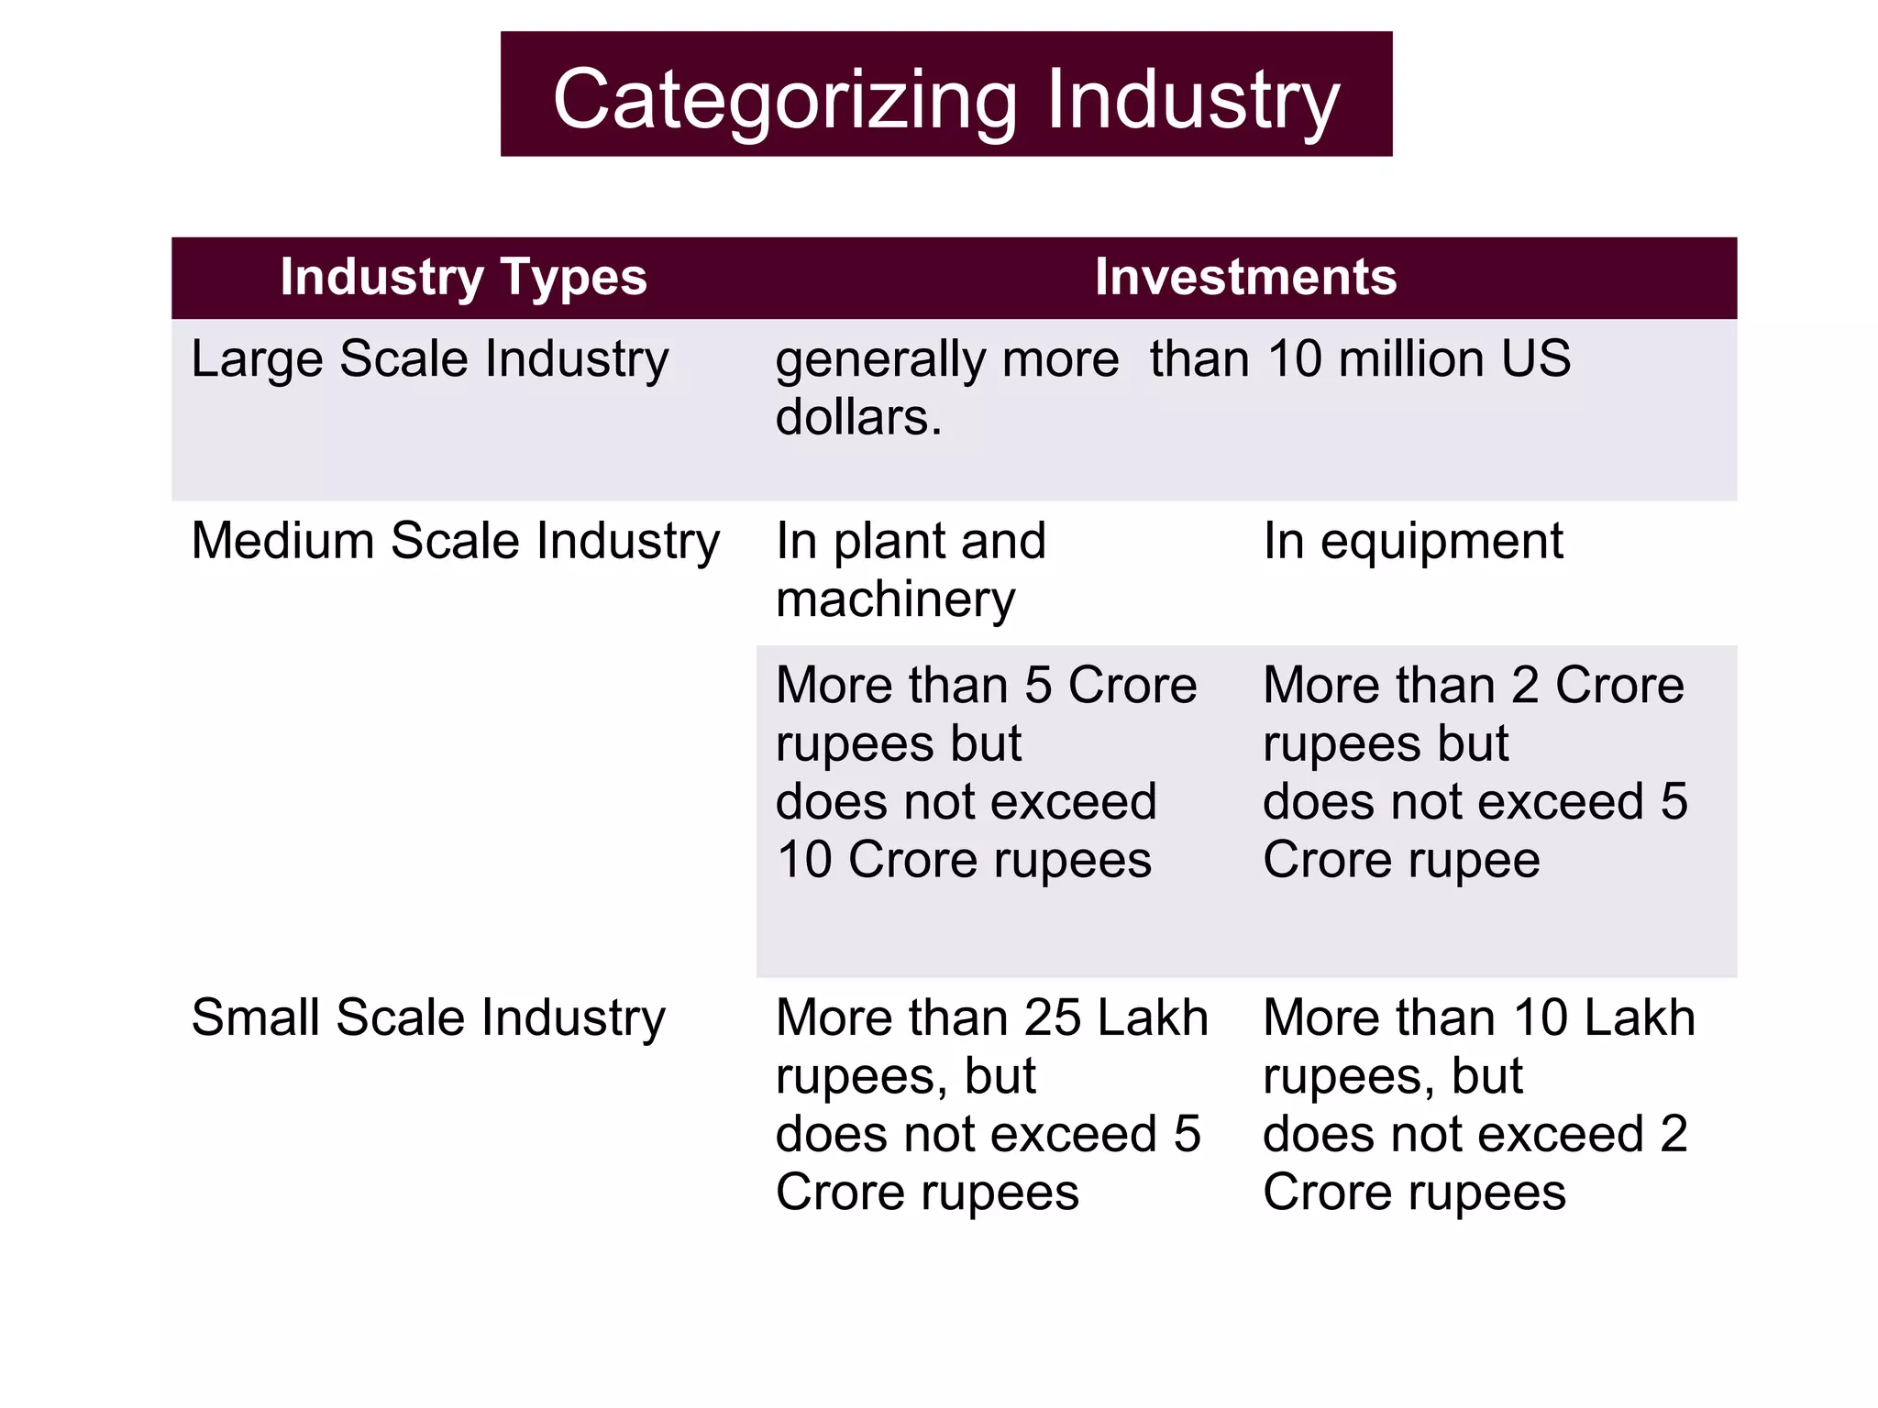
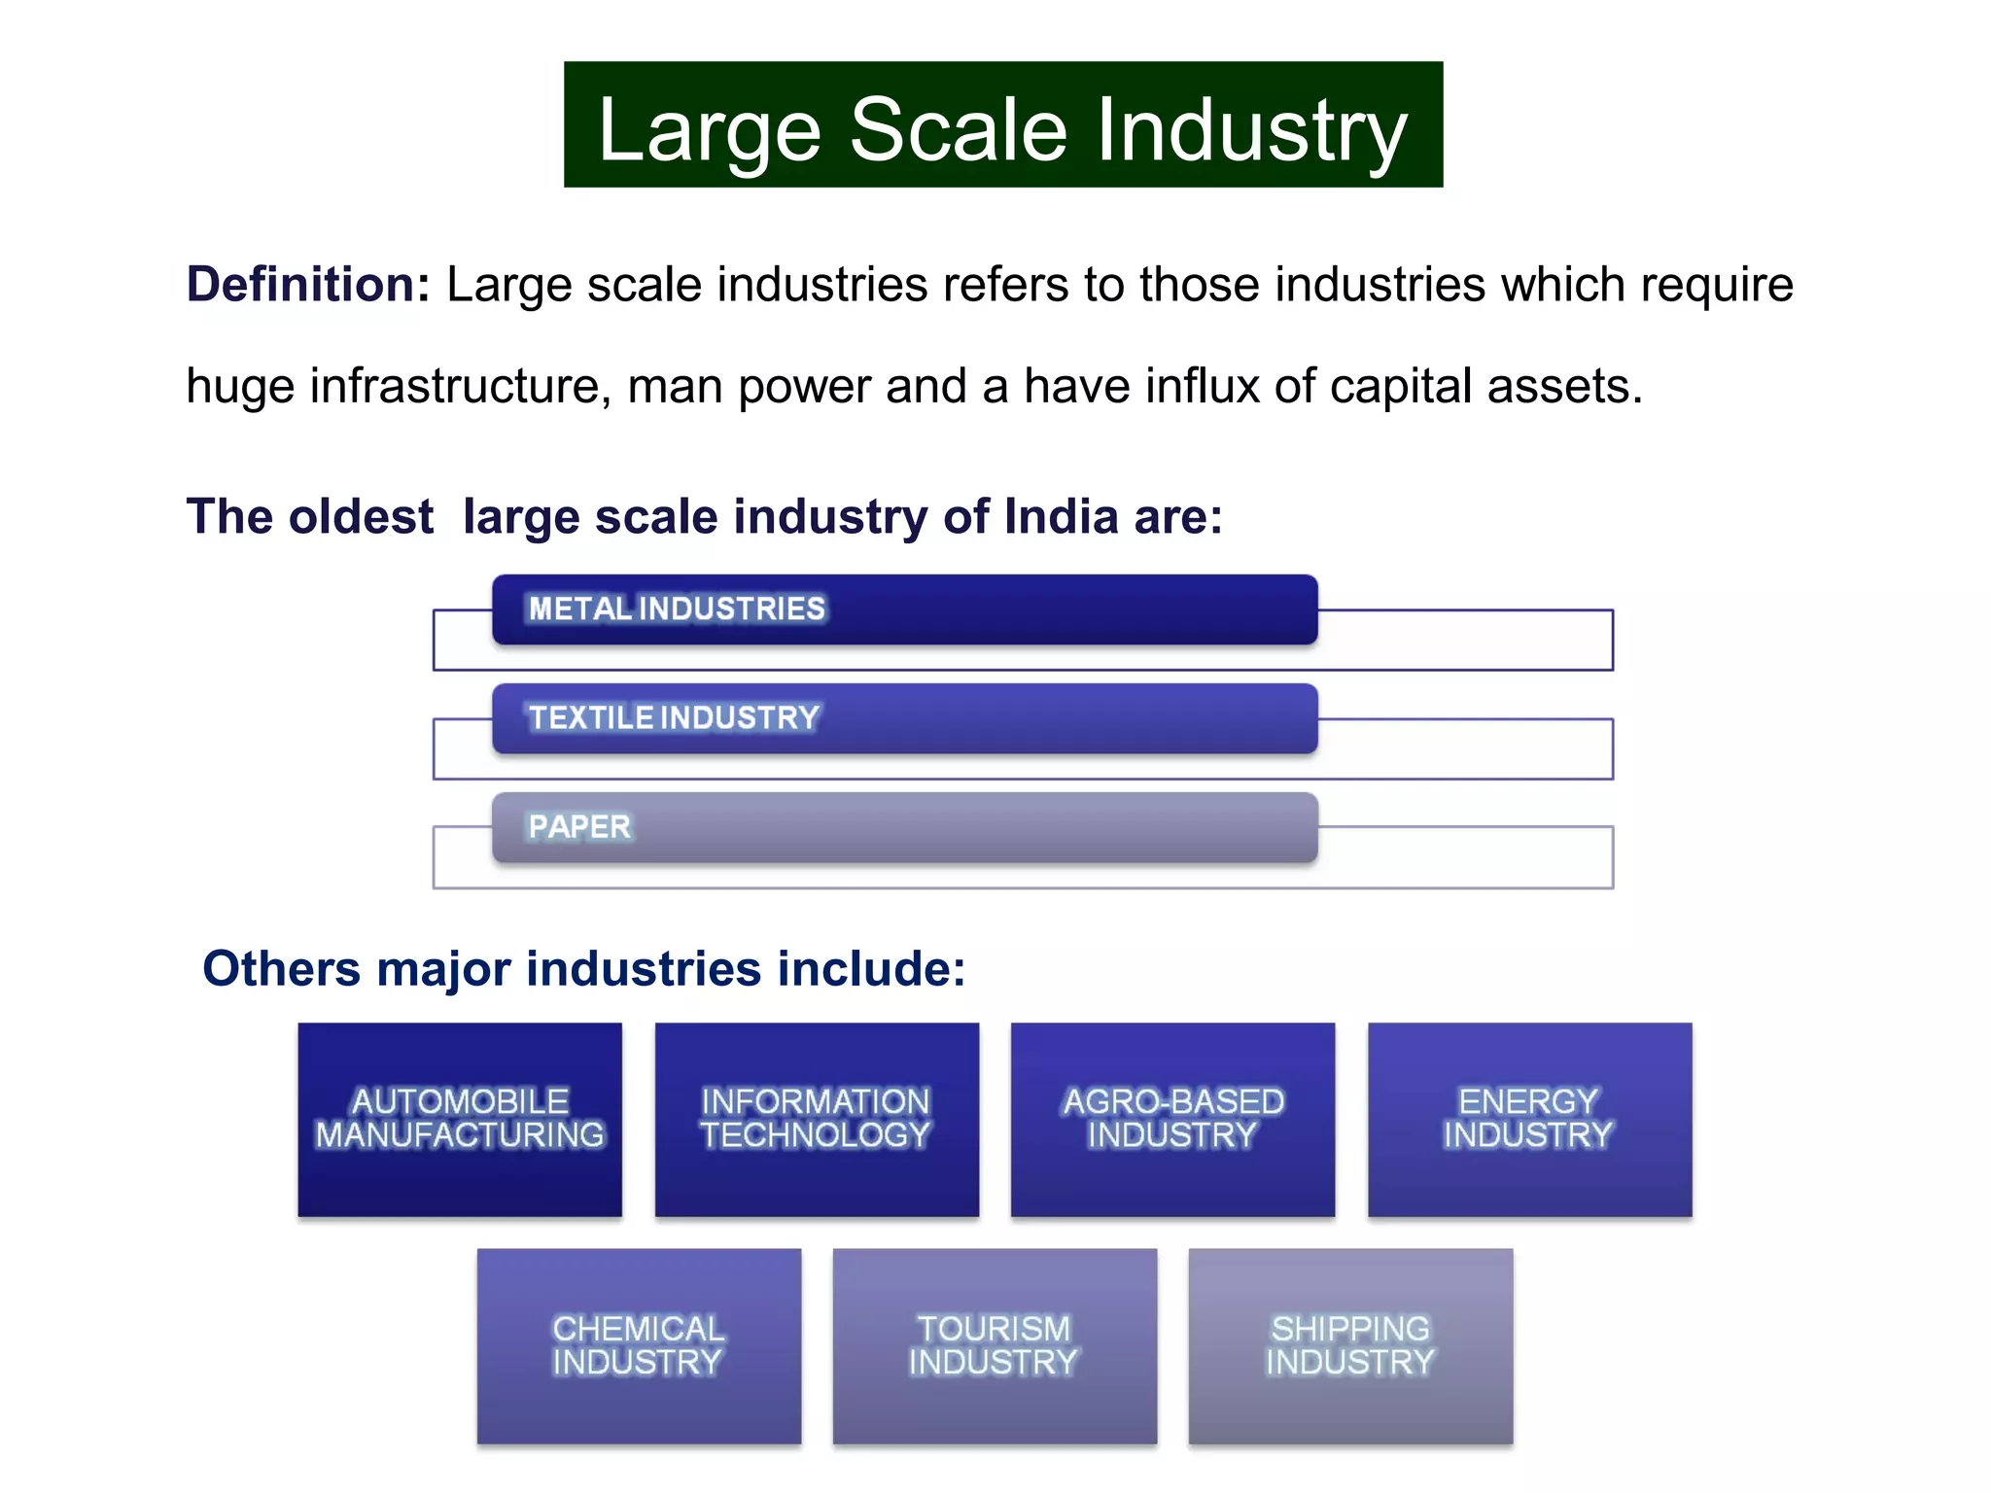
Indian Industries- Types

Slide 6
Indian Industries- Types
IT and Software Services
India's IT and software services sector experienced exponential growth, becoming a global hub for software development, IT outsourcing, and business process outsourcing (BPO). Cities like Bengaluru, Hyderabad, and Pune emerged as major technology hubs, attracting multinational corporations and contributing significantly to the country's export earnings.
Automobile Industry
The Indian automobile industry also witnessed remarkable growth, with both domestic and international players establishing manufacturing facilities in the country. This sector not only met the growing domestic demand but also became an export-oriented industry.
Service Sector Dominance:
The service sector emerged as the dominant contributor to India's Gross Domestic Product (GDP). Apart from IT services, other service industries such as banking, finance, insurance, healthcare, tourism, and entertainment grew substantially, creating significant employment opportunities.

Slide 7
Labour Policies
The Constitution of India under Article 41 directs the state to ensure public assistance in cases of unemployment, old age, sickness, and disablement, highlighting the government's responsibility towards the welfare of workers.
The Industrial Disputes Act, 1947, governs the resolution of industrial disputes, layoff, retrenchment, and related matters. It aims to promote industrial peace and safeguard the interests of both employers and employees.
The Minimum Wages Act, 1948, ensures that workers are paid a minimum wage, preventing exploitation and improving their standard of living.
The Factories Act, 1948, regulates the working conditions and safety standards in factories, ensuring the well-being of industrial workers.
The Maternity Benefit Act, 1961, provides maternity benefits to female employees, including paid leave during pregnancy and after childbirth.
The Employees' Provident Fund Organization (EPFO) manages the Employee Provident Fund (EPF), a retirement savings scheme for employees across various sectors.

Slide 8
Labour Problems
Informal Sector: A significant portion of India's workforce is employed in the informal sector, lacking job security, social benefits, and legal protections. This makes them vulnerable to exploitation and low wages.
Unemployment: India faces persistent issues of unemployment, especially among the youth. Rapid population growth and a mismatch between education and job requirements contribute to this problem.
Child Labour: Despite legislative measures, child labour remains a concern in India, particularly in sectors like agriculture, domestic work, and small-scale industries.
Exploitation and Low Wages: Many workers, especially in unorganized sectors, endure long working hours, low wages, and poor working conditions.
Occupational Health and Safety: Safety standards in various industries often fall short, leading to accidents and health issues for workers.
Contractual Employment: The prevalence of contract-based employment can lead to job insecurity and reduced access to benefits like health insurance or retirement plans.
Trade Union Challenges: While trade unions play a crucial role in advocating for workers' rights, some challenges include political affiliations, fragmented unionization, and occasional conflicts with employers.
Gender Inequality: Women often face discrimination and wage disparity in the workforce, making it challenging for them to access equal opportunities and growth.

Slide 9
Unorganized Sector
This sector comprises a wide range of economic activities, including small-scale enterprises, casual laborers, self-employed individuals, and household-based industries. It plays a crucial role in India's economy, accounting for a substantial share of employment and economic output.
Key characteristics of the unorganized sector in India include:
Lack of formal registration: Many businesses and workers in the unorganized sector are not registered with any government authority. This informal nature makes it challenging to track their activities accurately.
Limited legal protection: Workers in the unorganized sector often do not enjoy the same legal protections and social security benefits as formal employees, leaving them vulnerable to exploitation and economic risks.
Low wages and job insecurity: Jobs in the unorganized sector are often characterized by low wages and irregular working hours, leading to financial instability for workers and their families.
Informal work arrangements: In this sector, contracts are often verbal or based on informal arrangements, leading to uncertain working conditions.

Slide 10
Unorganized Sector
Small-scale enterprises: The unorganized sector includes numerous small-scale businesses and micro-enterprises, often operating in sectors like agriculture, construction, street vending, domestic work, and various informal services.
Lack of access to credit and resources: Businesses in the unorganized sector may face difficulties in accessing formal credit and resources due to their informal nature, limiting their growth potential.
Importance in rural and urban areas: The unorganized sector is present both in rural and urban areas, contributing significantly to the economy of India.
The unorganized sector has both positive and negative implications for the Indian economy. On one hand, it provides employment opportunities to a vast segment of the population and contributes to the country's economic growth. On the other hand, the lack of regulation and social security can lead to issues like income inequality, exploitation of workers, and limited productivity.

Slide 11
Manufacturing Sector Growth:
The manufacturing sector is one of the key components of India's industrial growth. It contributes significantly to the country's GDP and employment. According to data from India's Ministry of Statistics and Programme Implementation (MOSPI), the manufacturing sector's growth rate was as follows:
In 2019-2020, the manufacturing sector grew at a rate of around 0.03%.
In 2020-2021, due to the COVID-19 pandemic's impact, the manufacturing sector witnessed a contraction of about 6.2%.

Slide 12
Automobile Industry:
The automobile industry is a significant segment of the manufacturing sector in India. It includes passenger vehicles, commercial vehicles, two-wheelers, and three-wheelers. According to the Society of Indian Automobile Manufacturers (SIAM), the industry faced the following growth trends:
In 2019-2020, the automobile industry witnessed a decline of about 18.9%.
In 2020-2021, the industry rebounded somewhat with a decline of about 13.6%.

Slide 13
Information Technology (IT) Industry:
The IT industry is one of India's most prominent sectors, contributing significantly to export earnings and job creation. The National Association of Software and Service Companies (NASSCOM) provided the following growth figures:
In 2019-2020, the IT industry experienced growth of around 8.1%.
In 2020-2021, the industry faced challenges due to the pandemic but still managed to grow at a rate of approximately 2.3%.

Slide 14
Pharmaceutical Industry:
The pharmaceutical industry is another vital sector in India, known for its generics and vaccine manufacturing capabilities. According to the Indian Brand Equity Foundation (IBEF), the pharmaceutical industry exhibited the following growth rates:
In 2019-2020, the pharmaceutical sector registered growth of around 9.6%.
In 2020-2021, the industry remained resilient during the pandemic and achieved growth of about 10%.

Slide 15
Thank you

